Slide 1


Smart Agriculture System Using IoT & Blockchain
Ajay Kumar Garg Engineering College
Project Presentation (KIT-753)
Guided By,
Mr. Sanjay Sonker Associate Professor IT Department, AKGEC Ghaziabad
Presented By,
Aradhya Priyadarshi (2000270110021)
Harsh Tiwari (2000270130071)
Khushi Singh (2000270130087)

Slide 2
Abstract
Objective of The Project
Screenshots of The Project
Literature Review
Research Gap
DIAGRAMS
Screenshots of The Project
Outcome of The Project
References
Outline of The Presentation
Topics we will tackle

Slide 3
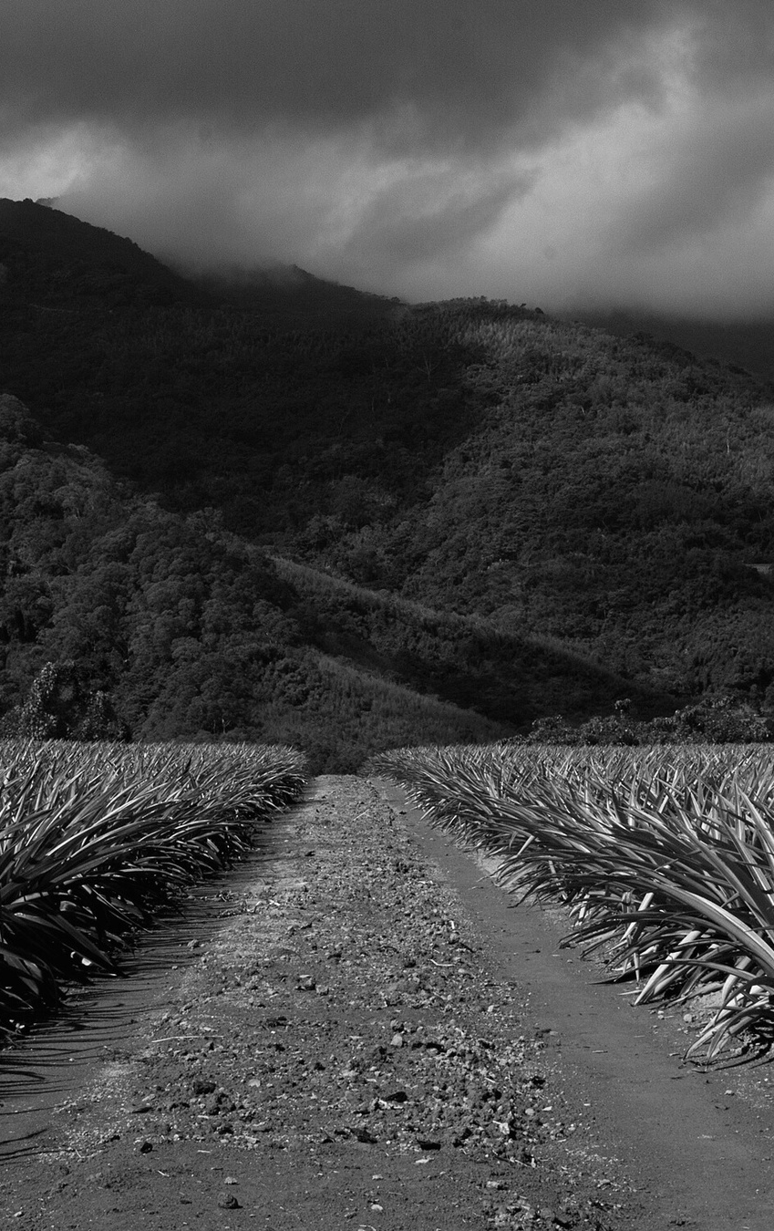
ABSTRACT
In response to the rising global demand for food production, there is an imperative need to integrate innovative technologies into conventional agricultural practices. This abstract introduces a transformative Smart Agriculture System poised to revolutionize crop management and bolster sustainability within the agricultural sector. Leveraging advanced sensor technologies, Internet of Things (IoT) devices, and artificial intelligence, our system establishes a seamless ecosystem. This cohesive infrastructure actively monitors, analyzes, and optimizes diverse facets of crop cultivation, providing farmers with unprecedented insights and tools for informed decision-making.

Slide 4

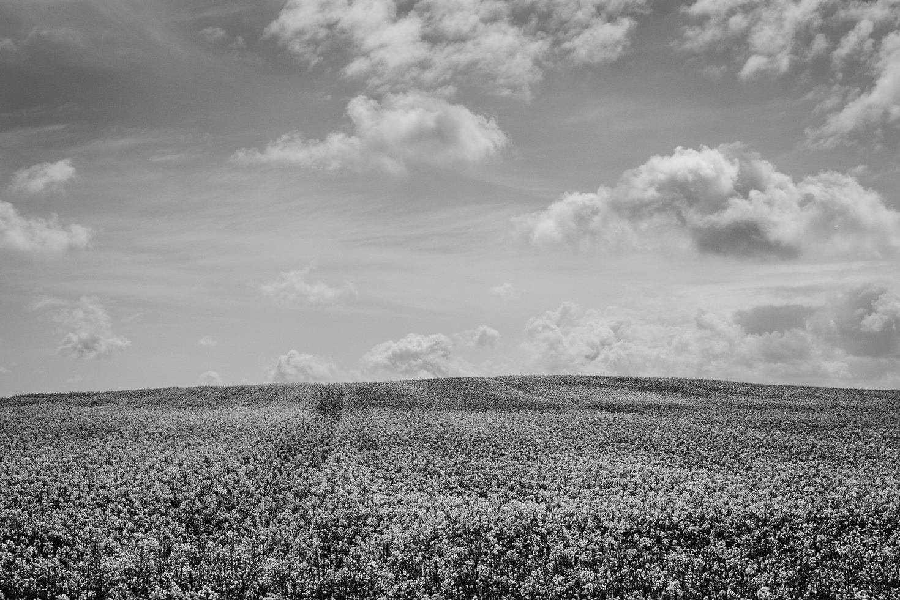
Objective of the
Project
Production Quality: The wellness and nutrition of people from all socioeconomic strata in the nation can be significantly impacted by the quality of food produced. A country’s population will live longer and in better health with better food, which will improve its citizens’ economic contribution.
Effectiveness Of Farming Practices and Resource Use: The application of smart technologies to conventional agricultural operations can increase their effectiveness. In turn, this encourages more efficient use of agricultural resources.
Reducing Wastage: The farming industry, one of the main economic sectors, is in great part to blame for the massive quantities of food and other secondary resources that are wasted. Smart technology could be employed to track and cut down on this waste.
Effective Use of Time: Timely delivery of the necessary insecticides, fertilizers, and other chemicals can provide timely and high-quality agricultural output with fewer losses thanks to smart agriculture.

Slide 5



Objective Of The Project
Current Objectives
Revolutionizing Traditional Farming
Enabling IoT and CyberSecurity Technologies for Agriculture 4.0
Promoting Sustainable Farming

Slide 6
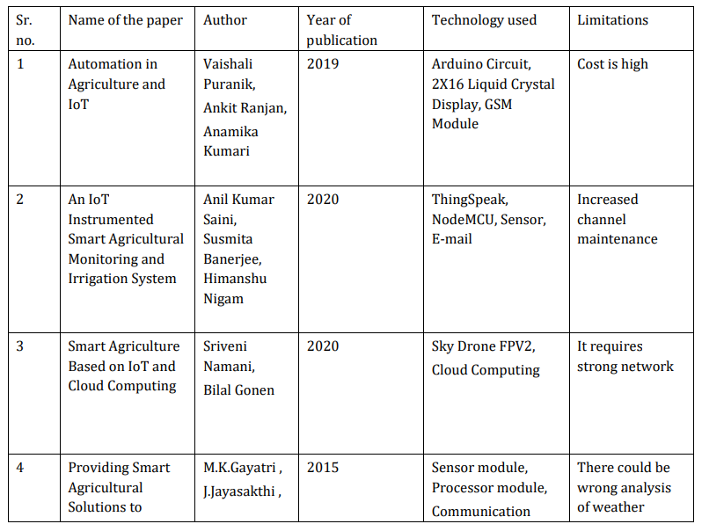
Literature Review

Slide 7
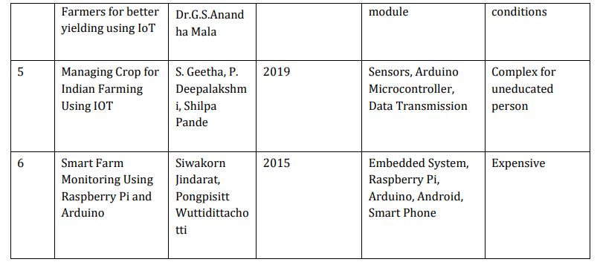
Literature Review (Continued…)

Slide 8

Research Gap
Our project uniquely addresses critical gaps in current Smart Agriculture Systems: Contextual Adaptability: Tailoring solutions to diverse agro-climatic conditions, local practices, and economic factors for a more inclusive and adaptable system.
User-Centric Design: Focusing on farmer attitudes and preferences to enhance usability and promote seamless integration into existing workflows.
Data Security and Privacy: Developing robust frameworks for secure data collection, transmission, and ownership to address concerns and build trust.
Holistic Sustainability Metrics: Expanding sustainability assessment beyond productivity and efficiency to include social, environmental, and long-term ecological impacts.

Slide 9
OVERALL SYSTEM ARCHITECTURE
CLASS DIAGRAM

Slide 10
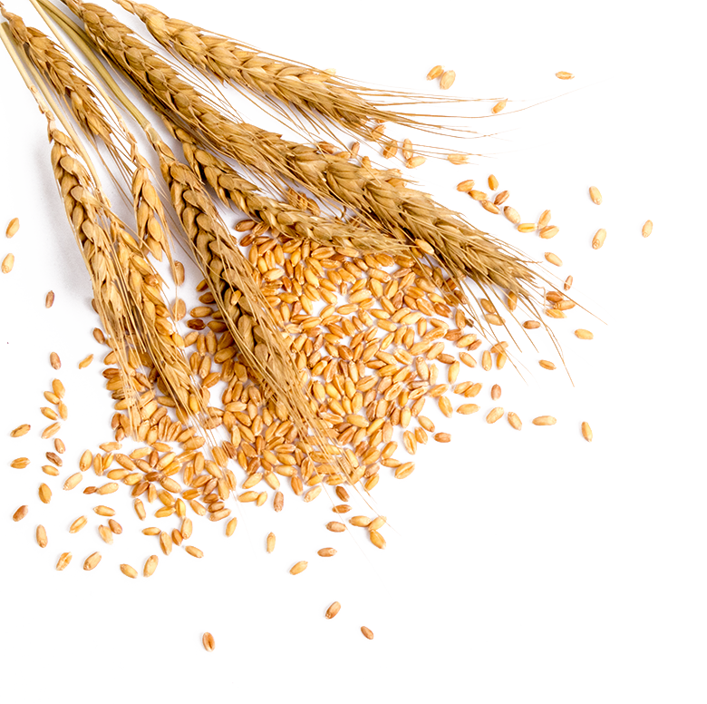
USE CASE DIAGRAM

Slide 11
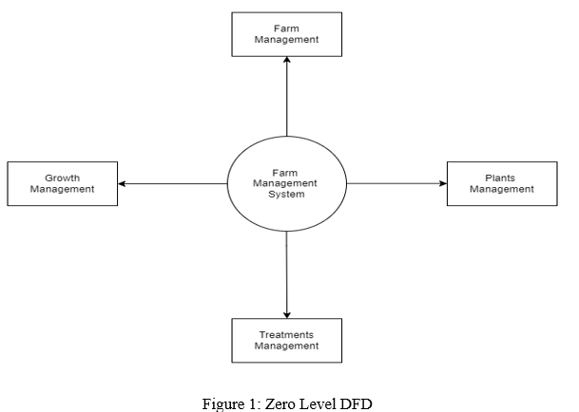
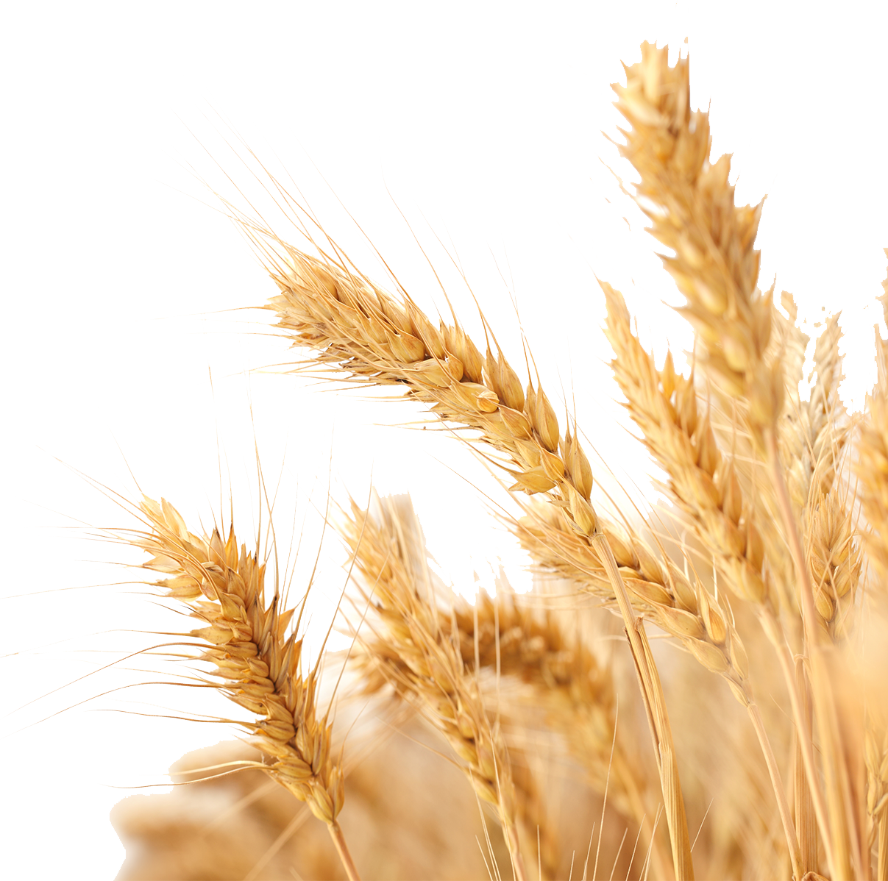
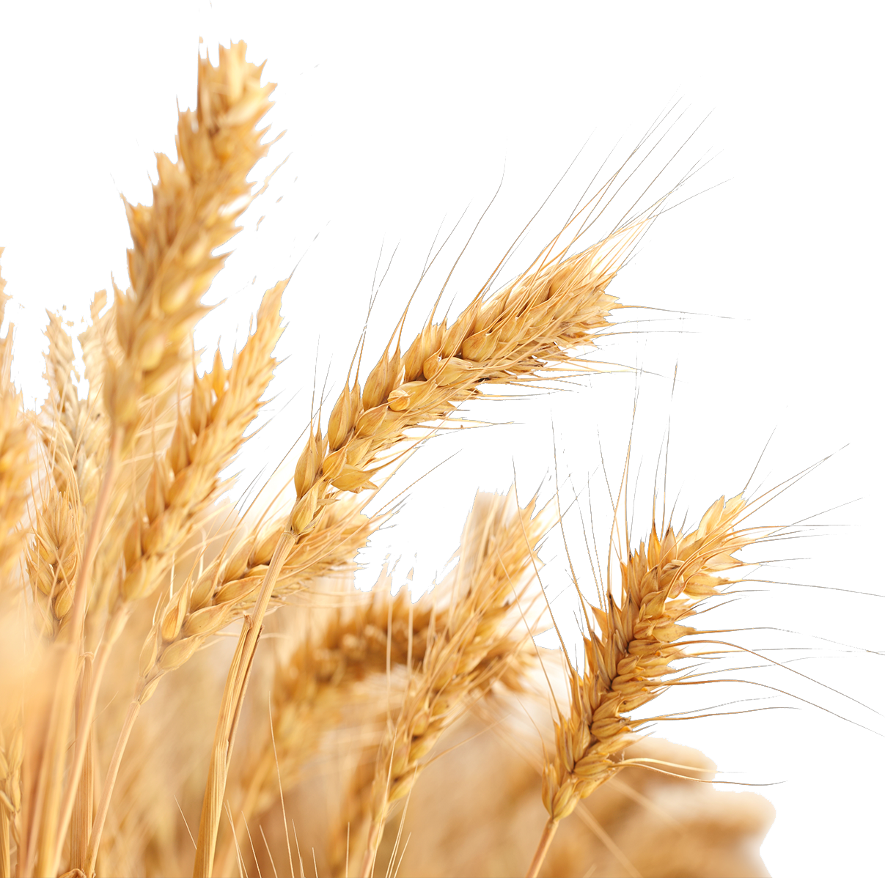


DATA FLOW DIAGRAM
Zero Level Diagram

Slide 12
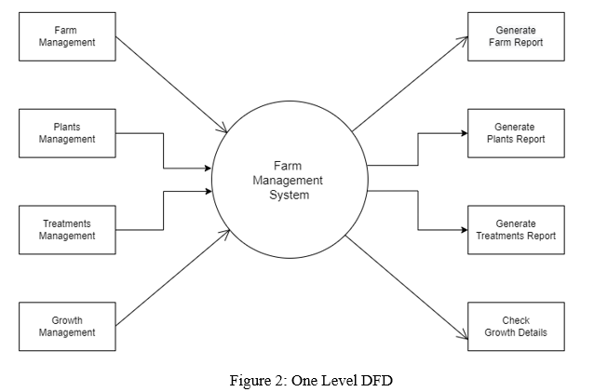

DATA FLOW DIAGRAM
One Level Diagram

Slide 13
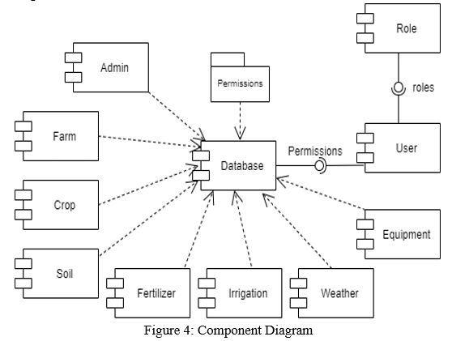
Component Diagram

Slide 14
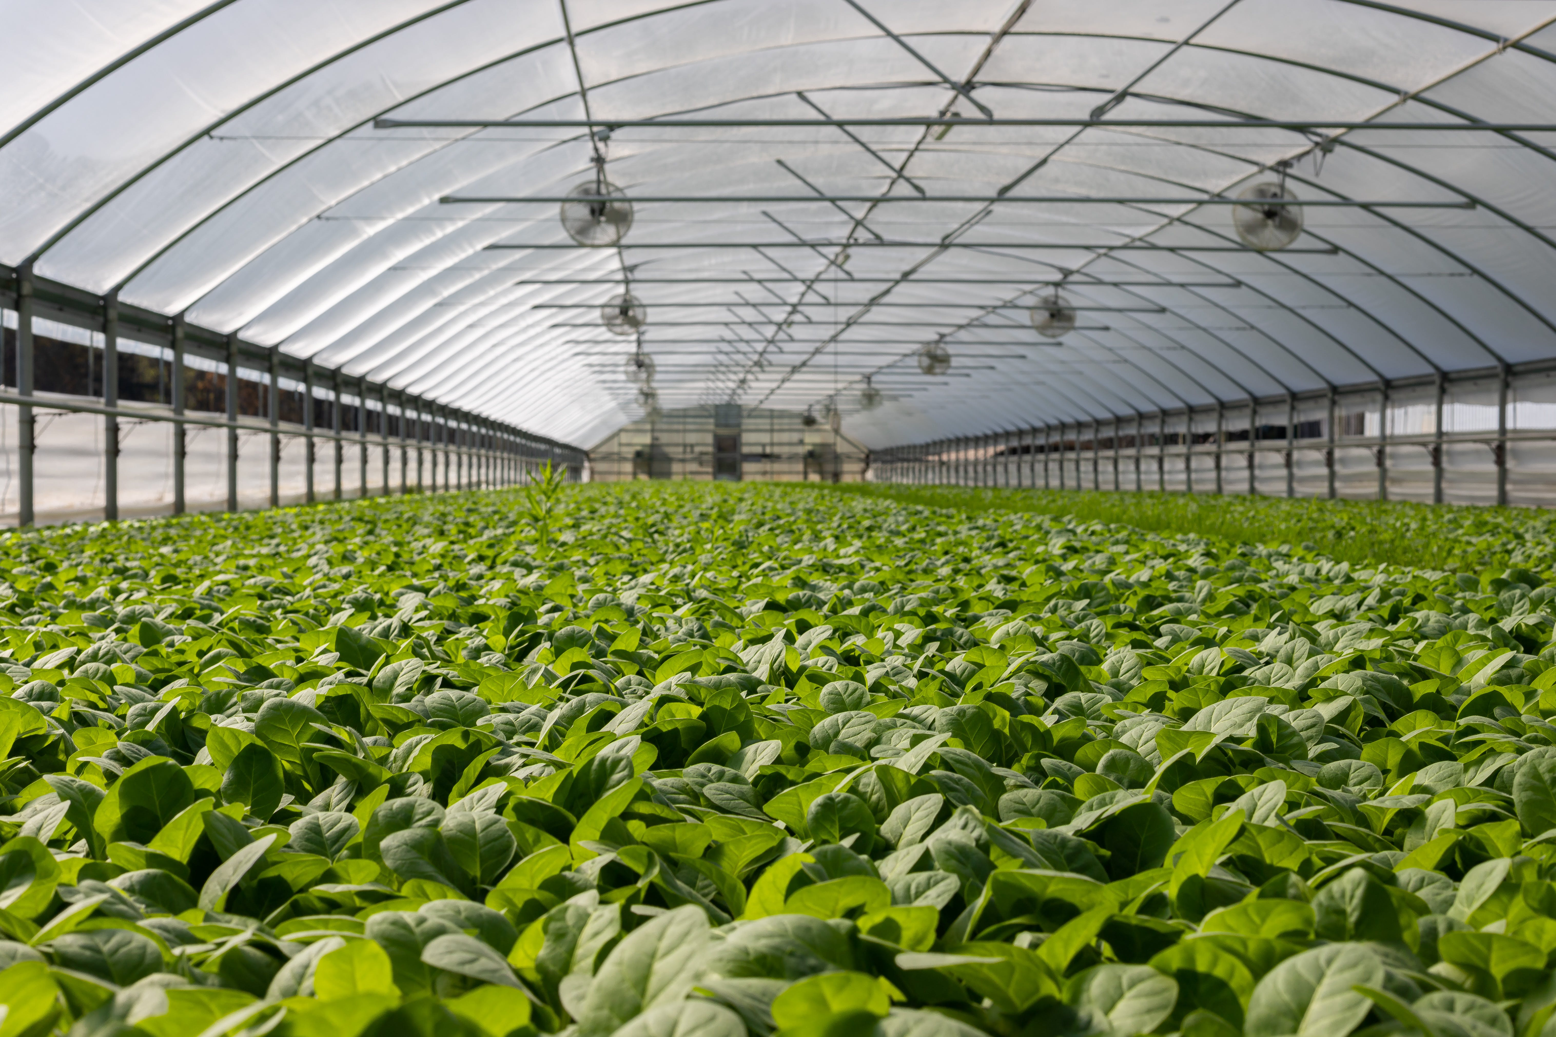
Screenshots of The Project

Slide 15
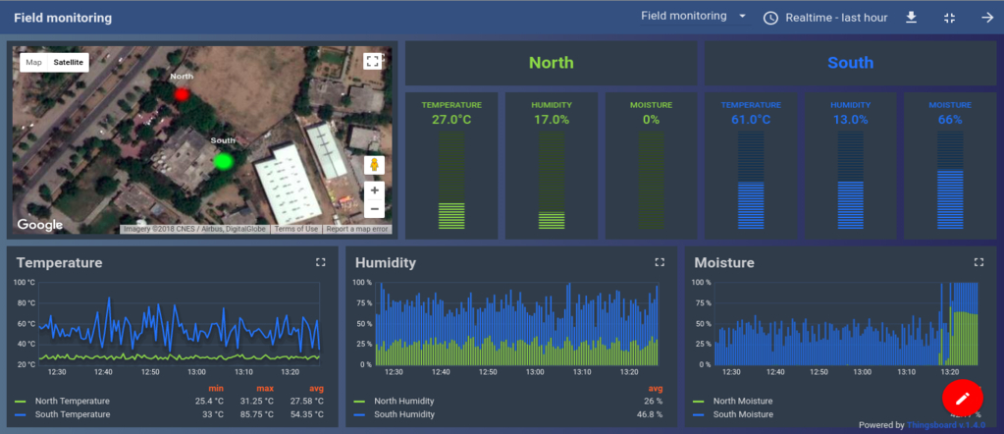

Slide 16
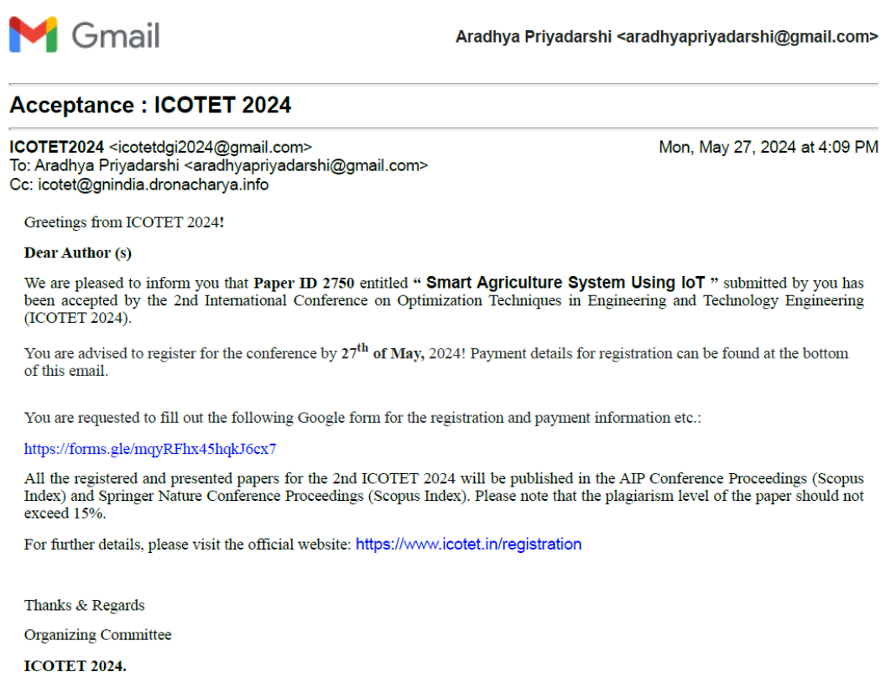
Project Research Paper Acceptance Acknowledgement

Slide 17
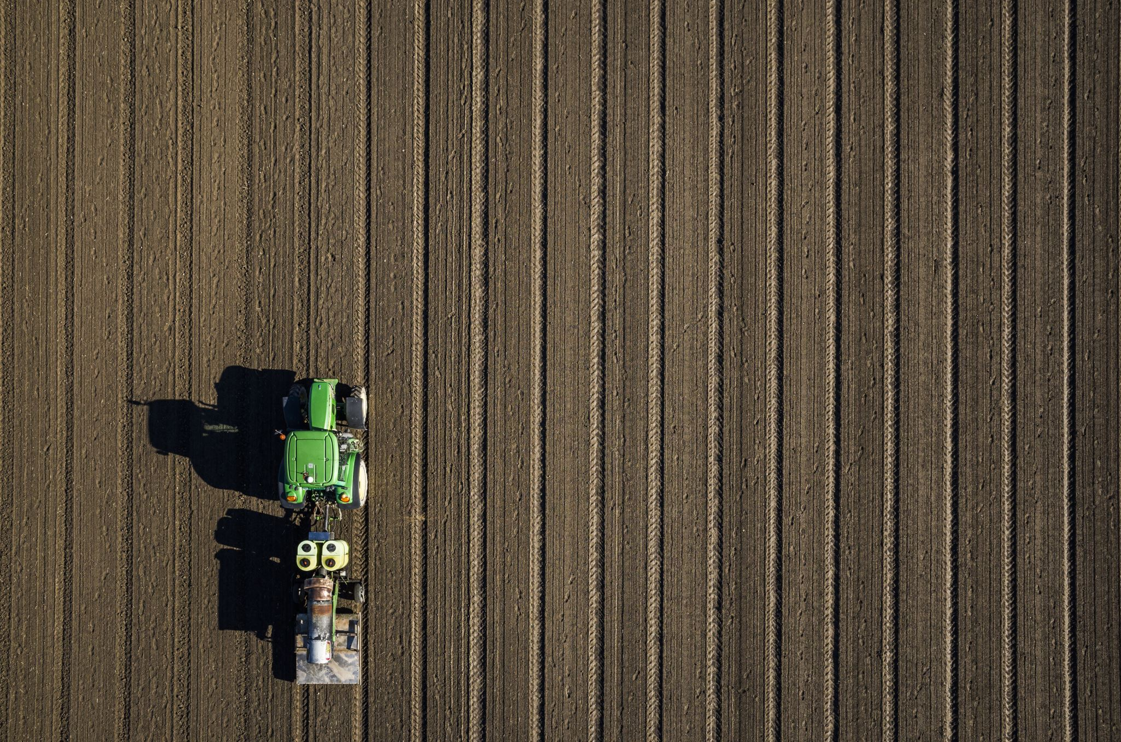
Project Link
https://shorturl.at/so6On

Slide 18
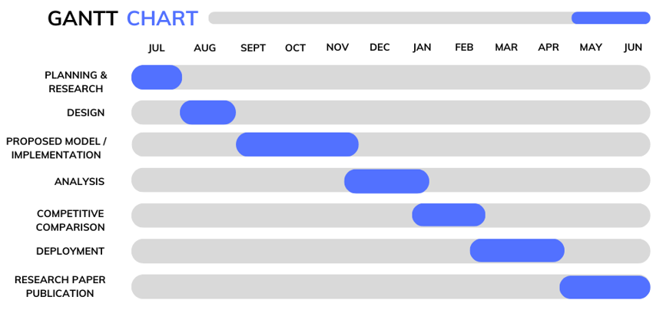
Gantt Chart

Slide 19
Project Outcome
In this study, we suggested a security framework for the agricultural internet of things that integrates blockchain technology, fog computing, and software-defined networking.
Here, for IoT connectivity, each SDN controller is linked to a blockchain. SDN controllers are interconnected by a network’s topology. One of the key objectives of the proposed architecture is to enhance communication security for IoT devices.
For IoT devices with limited resources, distributed trust-based verification makes blockchain even more useful. With a focus on fixing security and data reliability issues in a distributed controller context.

Slide 20
References
Vangala, A.; Sutrala, A.K.; Das, A.K.; Jo, M. Smart Contract-Based Blockchain-Envisioned Authentication Scheme for Smart Farming. IEEE Internet Things J. 2021, 8, 10792–10806.
Abbasi, R.; Martinez, P.; Ahmad, R. The digitization of agricultural industry–a systematic literature review on agriculture 4.0. Smart Agric. Technol. 2022, 2, 100042.
Akinwumi, S.A.; Ezenwosu, A.C.; Omotosho, T.V.; Adewoyin, O.O.; Adagunodo, T.A.; Oyeyemi, K.D. Arduino Based Security System using Passive Infrared (PIR) Motion Sensor. In IOP Conference Series: Earth and Environmental Science; IOP Publishing: Bristol, UK, 2021; Volume 655, p. 012039.
Albiero, D.; Paulo, R.L.D.; Félix Junior, J.C.; Santos, J.D.S.G.; Melo, R.P. Agriculture 4.0: A terminological introduction. Rev. Ciência Agronômica 2021, 51, e20207737.
Altalak, M.; Ammad uddin, M.; Alajmi, A.; Rizg, A. Smart Agriculture Applications Using Deep Learning Technologies: A Survey. Appl. Sci. 2022, 12, 5919.

Slide 21
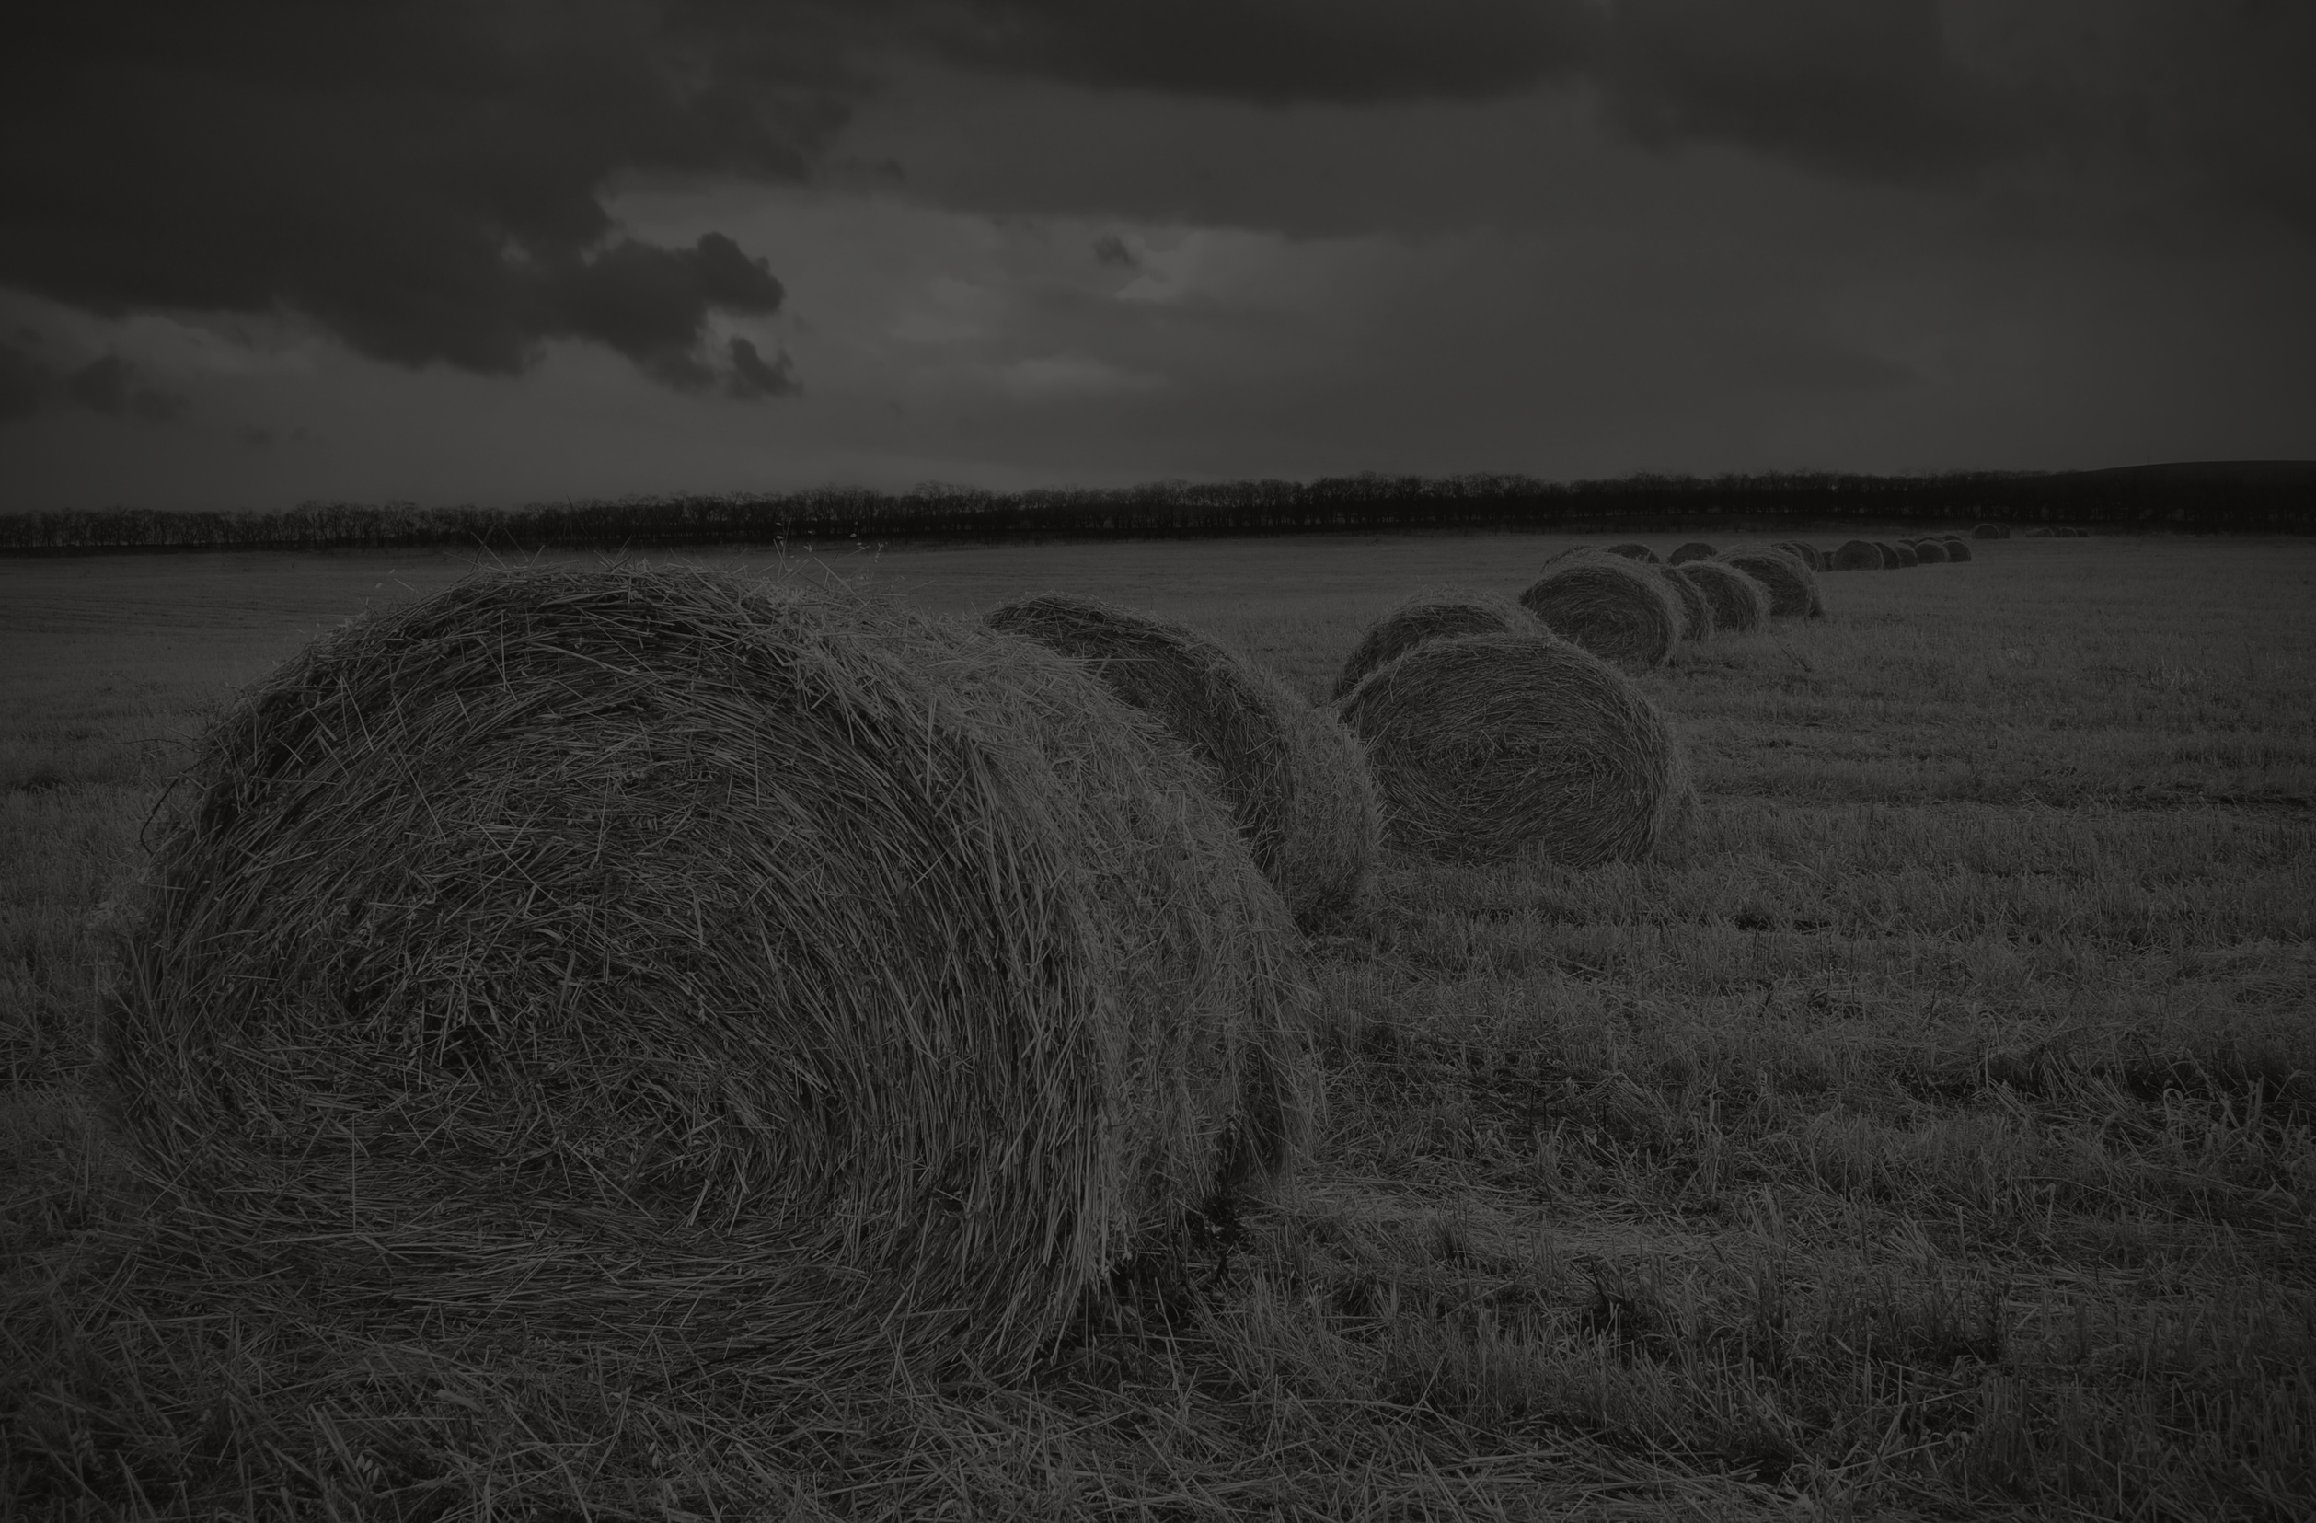
Thank You !

